Slide 1

Special Article Fine-Particulate Air Pollution and Life Expectancy in the United States
C. Arden Pope, III, Ph.D., Majid Ezzati, Ph.D., and Douglas W. Dockery, Sc.D.
N Engl J Med
Volume 360(4):376-386
January 22, 2009

Slide 2
Study Overview
Particulate air pollution has been implicated as being responsible for deaths from any cause.
This epidemiologic study examined the change in fine-particulate air pollution in 51 U.S. metropolitan areas between the late 1970s and the late 1990s.
A decrease in fine-particulate air pollution was associated with increased life expectancy.

Slide 3
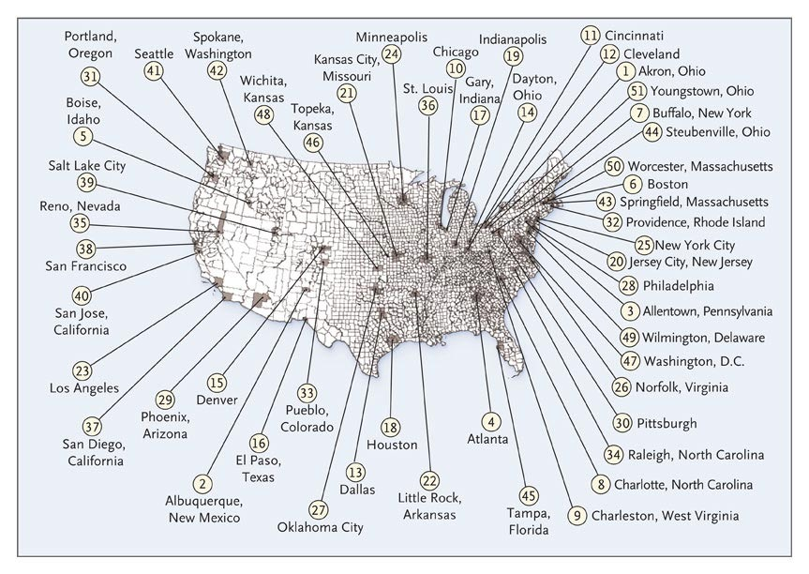
Distribution of Study Areas.
Pope CA II et al. N Engl J Med2009;360:376-386
Notes:
Figure 1 Distribution of Study Areas. The locations of the counties included in the study are shown in gray, and the dots represent the approximate locations of the 51 metropolitan areas in the study. The metropolitan areas are coded by number as follows: 1 — Akron, Ohio; 2 — Albuquerque, New Mexico; 3 — Allentown, Pennsylvania; 4 — Atlanta; 5 — Boise, Idaho; 6 — Boston; 7 — Buffalo, New York; 8 — Charlotte, North Carolina; 9 — Charleston, West Virginia; 10 — Chicago; 11 — Cincinnati; 12 — Cleveland; 13 — Dallas; 14 — Dayton, Ohio; 15 — Denver; 16 — El Paso, Texas; 17 — Gary, Indiana; 18 — Houston; 19 — Indianapolis; 20 — Jersey City, New Jersey; 21 — Kansas City, Missouri; 22 — Little Rock, Arkansas; 23 — Los Angeles; 24 — Minneapolis; 25 — New York City; 26 — Norfolk, Virginia; 27 — Oklahoma City; 28 — Philadelphia; 29 — Phoenix, Arizona; 30 — Pittsburgh; 31 — Portland, Oregon; 32 — Providence, Rhode Island; 33 — Pueblo, Colorado; 34 — Raleigh, North Carolina; 35 — Reno, Nevada; 36 — St. Louis; 37 — San Diego, California; 38 — San Francisco; 39 — Salt Lake City; 40 — San Jose, California; 41 — Seattle; 42 — Spokane, Washington; 43 — Springfield, Massachusetts; 44 — Steubenville, Ohio; 45 — Tampa, Florida; 46 — Topeka, Kansas; 47 — Washington, D.C.; 48 — Wichita, Kansas; 49 — Wilmington, Delaware; 50 — Worcester, Massachusetts; 51 — Youngstown, Ohio.

Slide 4
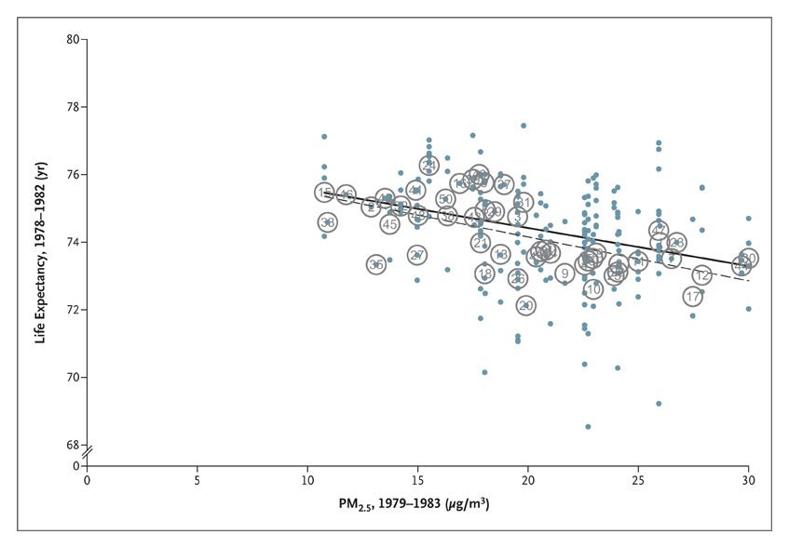
Cross-Sectional Life Expectancies for 1978–1982, Plotted against PM2.5 Concentrations for 1979–1983.
Pope CA II et al. N Engl J Med2009;360:376-386
Notes:
Figure 2 Cross-Sectional Life Expectancies for 1978–1982, Plotted against PM_{2.5} Concentrations for 1979–1983. Dots and circles labeled with numbers represent population-weighted mean life expectancies at the county level and the metropolitan-area level, respectively. The solid and broken lines represent regression lines with the use of county-level and metropolitan-area–level observations, respectively. The metropolitan areas are coded by number as follows: 1 — Akron, Ohio; 2 — Albuquerque, New Mexico; 3 — Allentown, Pennsylvania; 4 — Atlanta; 5 — Boise, Idaho; 6 — Boston; 7 — Buffalo, New York; 8 — Charlotte, North Carolina; 9 — Charleston, West Virginia; 10 — Chicago; 11 — Cincinnati; 12 — Cleveland; 13 — Dallas; 14 — Dayton, Ohio; 15 — Denver; 16 — El Paso, Texas; 17 — Gary, Indiana; 18 — Houston; 19 — Indianapolis; 20 — Jersey City, New Jersey; 21 — Kansas City, Missouri; 22 — Little Rock, Arkansas; 23 — Los Angeles; 24 — Minneapolis; 25 — New York City; 26 — Norfolk, Virginia; 27 — Oklahoma City; 28 — Philadelphia; 29 — Phoenix, Arizona; 30 — Pittsburgh; 31 — Portland, Oregon; 32 — Providence, Rhode Island; 33 — Pueblo, Colorado; 34 — Raleigh, North Carolina; 35 — Reno, Nevada; 36 — St. Louis; 37 — San Diego, California; 38 — San Francisco; 39 — Salt Lake City; 40 — San Jose, California; 41 — Seattle; 42 — Spokane, Washington; 43 — Springfield, Massachusetts; 44 — Steubenville, Ohio; 45 — Tampa, Florida; 46 — Topeka, Kansas; 47 — Washington, D.C.; 48 — Wichita, Kansas; 49 — Wilmington, Delaware; 50 — Worcester, Massachusetts; 51 — Youngstown, Ohio. PM_{2.5} denotes particulate matter with an aerodynamic diameter less than or equal to 2.5 μm. (See interactive graphic.)

Slide 5
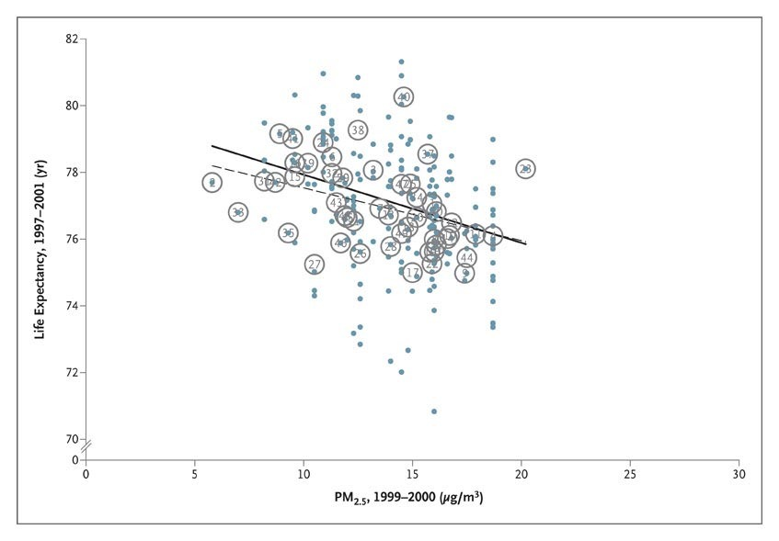
Cross-Sectional Life Expectancies for 1997–2001, Plotted against PM2.5 Concentrations for 1999–2000.
Pope CA II et al. N Engl J Med2009;360:376-386
Notes:
Figure 3 Cross-Sectional Life Expectancies for 1997–2001, Plotted against PM_{2.5} Concentrations for 1999–2000. Dots and circles labeled with numbers represent population-weighted mean life expectancies at the county level and the metropolitan-area level, respectively. The solid and broken lines represent regression lines with the use of county-level and metropolitan-area–level observations, respectively. The metropolitan areas are coded by number as follows: 1 — Akron, Ohio; 2 — Albuquerque, New Mexico; 3 — Allentown, Pennsylvania; 4 — Atlanta; 5 — Boise, Idaho; 6 — Boston; 7 — Buffalo, New York; 8 — Charlotte, North Carolina; 9 — Charleston, West Virginia; 10 — Chicago; 11 — Cincinnati; 12 — Cleveland; 13 — Dallas; 14 — Dayton, Ohio; 15 — Denver; 16 — El Paso, Texas; 17 — Gary, Indiana; 18 — Houston; 19 — Indianapolis; 20 — Jersey City, New Jersey; 21 — Kansas City, Missouri; 22 — Little Rock, Arkansas; 23 — Los Angeles; 24 — Minneapolis; 25 — New York City; 26 — Norfolk, Virginia; 27 — Oklahoma City; 28 — Philadelphia; 29 — Phoenix, Arizona; 30 — Pittsburgh; 31 — Portland, Oregon; 32 — Providence, Rhode Island; 33 — Pueblo, Colorado; 34 — Raleigh, North Carolina; 35 — Reno, Nevada; 36 — St. Louis; 37 — San Diego, California; 38 — San Francisco; 39 — Salt Lake City; 40 — San Jose, California; 41 — Seattle; 42 — Spokane, Washington; 43 — Springfield, Massachusetts; 44 — Steubenville, Ohio; 45 — Tampa, Florida; 46 — Topeka, Kansas; 47 — Washington, D.C.; 48 — Wichita, Kansas; 49 — Wilmington, Delaware; 50 — Worcester, Massachusetts; 51 — Youngstown, Ohio. PM_{2.5} denotes particulate matter with an aerodynamic diameter less than or equal to 2.5 μm. (See interactive graphic.)

Slide 6
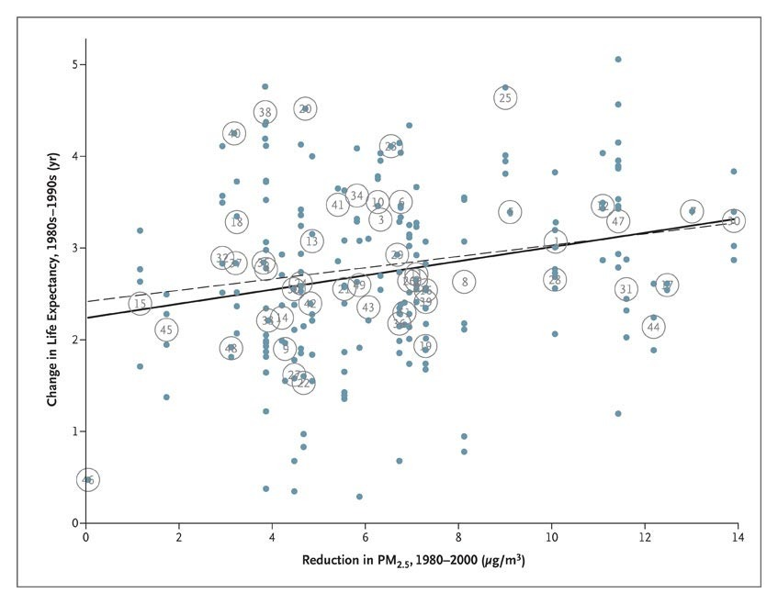
Changes in Life Expectancy for the 1980s–1990s, Plotted against Reductions in PM2.5 Concentrations for 1980–2000.
Pope CA II et al. N Engl J Med2009;360:376-386
Notes:
Figure 4 Changes in Life Expectancy for the 1980s–1990s, Plotted against Reductions in PM_{2.5} Concentrations for 1980–2000. Dots and circles labeled with numbers represent changes in population-weighted mean life expectancies at the county level and metropolitan-area level, respectively. The solid and broken lines represent regression lines with the use of county-level and metropolitan-area–level observations, respectively. The metropolitan areas are coded by number as follows: 1 — Akron, Ohio; 2 — Albuquerque, New Mexico; 3 — Allentown, Pennsylvania; 4 — Atlanta; 5 — Boise, Idaho; 6 — Boston; 7 — Buffalo, New York; 8 — Charlotte, North Carolina; 9 — Charleston, West Virginia; 10 — Chicago; 11 — Cincinnati; 12 — Cleveland; 13 — Dallas; 14 — Dayton, Ohio; 15 — Denver; 16 — El Paso, Texas; 17 — Gary, Indiana; 18 — Houston; 19 — Indianapolis; 20 — Jersey City, New Jersey; 21 — Kansas City, Missouri; 22 — Little Rock, Arkansas; 23 — Los Angeles; 24 — Minneapolis; 25 — New York City; 26 — Norfolk, Virginia; 27 — Oklahoma City; 28 — Philadelphia; 29 — Phoenix, Arizona; 30 — Pittsburgh; 31 — Portland, Oregon; 32 — Providence, Rhode Island; 33 — Pueblo, Colorado; 34 — Raleigh, North Carolina; 35 — Reno, Nevada; 36 — St. Louis; 37 — San Diego, California; 38 — San Francisco; 39 — Salt Lake City; 40 — San Jose, California; 41 — Seattle; 42 — Spokane, Washington; 43 — Springfield, Massachusetts; 44 — Steubenville, Ohio; 45 — Tampa, Florida; 46 — Topeka, Kansas; 47 — Washington, D.C.; 48 — Wichita, Kansas; 49 — Wilmington, Delaware; 50 — Worcester, Massachusetts; 51 — Youngstown, Ohio. PM_{2.5} denotes particulate matter with an aerodynamic diameter less than or equal to 2.5 μm. (See interactive graphic.)

Slide 7
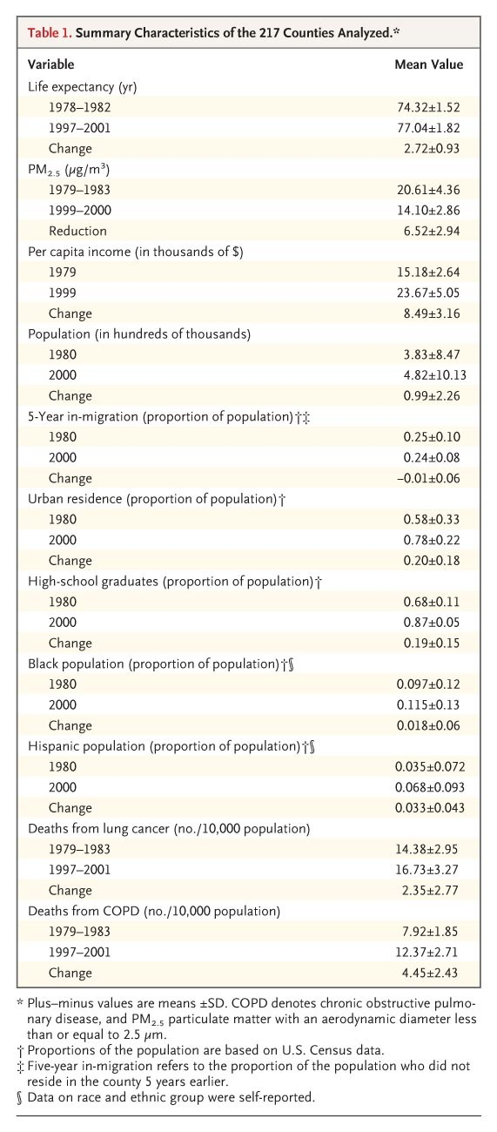
Summary Characteristics of the 217 Counties Analyzed.
Pope CA II et al. N Engl J Med2009;360:376-386
Notes:
Table 1 Summary Characteristics of the 217 Counties Analyzed.

Slide 8
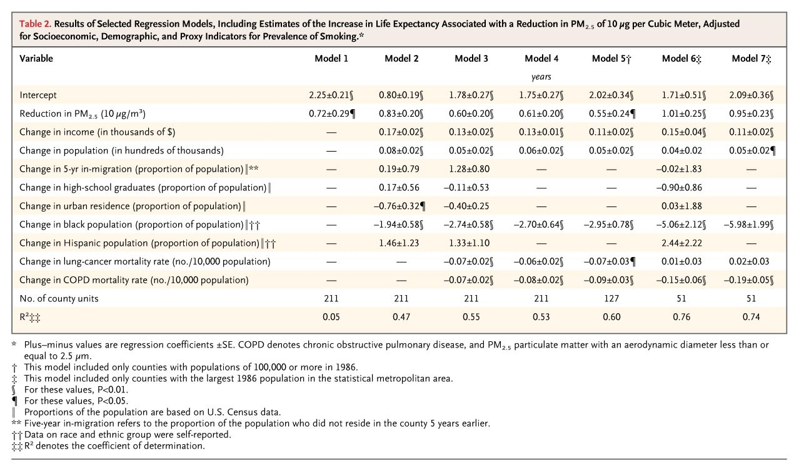
Results of Selected Regression Models, Including Estimates of the Increase in Life Expectancy Associated with a Reduction in PM2.5 of 10 μg per Cubic Meter, Adjusted for Socioeconomic, Demographic, and Proxy Indicators for Prevalence of Smoking.
Pope CA II et al. N Engl J Med2009;360:376-386
Notes:
Table 2 Results of Selected Regression Models, Including Estimates of the Increase in Life Expectancy Associated with a Reduction in PM_{2.5} of 10 μg per Cubic Meter, Adjusted for Socioeconomic, Demographic, and Proxy Indicators for Prevalence of Smoking.

Slide 9
Conclusions
A reduction in exposure to ambient fine-particulate air pollution contributed to significant and measurable improvements in life expectancy in the United States.

